Slide 1

Recommendation System for Movies
An analysis of Movie lens Data

Slide 2
Topic Overview
Problem
Dataset
Analysis and Result
Machine Learning
Conclusion
Recommendation

Slide 3
Why we need Recommendation system?
It has been estimated that there are approximately 500,000 movies currently in existence.
This situation creates `selection pressure’ on individual movies, as not all movies are equally popular.
The audience will not be spending their time watching every movie available to them, they will pick randomly something to watch.
If a person picks a movie and does not enjoy it there will be no positive word-of-mouth.
This doesn’t necessarily mean the movie was bad, it might mean it was not interesting to that individual. This is where the recommendation system is helpful.
Recommendation system helps the user find items of their interest and Helps the item provider to deliver their items to the right user.
It increases revenues for business through increased consumption.

Slide 4

Dataset
metadata for all 45,000 movies listed in the Full Movie Lens Dataset.
The dataset consists of movies released on or before July 2017.
This dataset also has files containing 26 million ratings from 270,000 users for all 45,000 movies.

Slide 5
Data Wrangling
The dataset has a record of 45466 movies with 24 columns(features).Dropped columns with more than 50% of its total data with null values.
Converted budget feature into a numeric variable and replaced all the non-numeric values with NaN.
Extracted feature "Release Year" from "Release Date." "Release Year" is the year in which the movie was released.
Calculated the Net Profit/Loss using features "Revenue" and "budget.“
Dropped features like adult, id, original_title, poster_path, video as does not provide useful information.
Converted vote_count, and vote_average to float type from object.

Slide 6
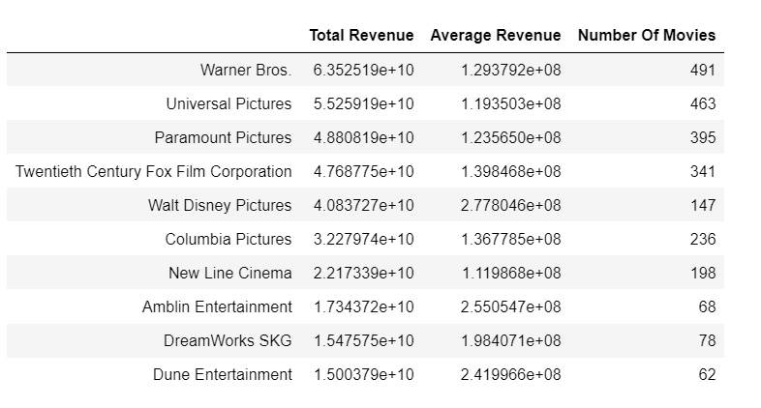
Which Production companies make most money in movie business?
Warner Bros is the highest-earning production company of all time, earning a staggering 63.5 billion dollars from close to 500 movies.
Universal Pictures and Paramount Pictures are the second and the third highest-earning companies with 55 billion dollars and 48 billion dollars in revenue.
As we are aware, Warner Bros and Universal Pictures are bigger studios compared to others on the list.
Thus it would be more appropriate to look at the average revenue of studios. We will consider studios that have produced at least ten movies.

Slide 7
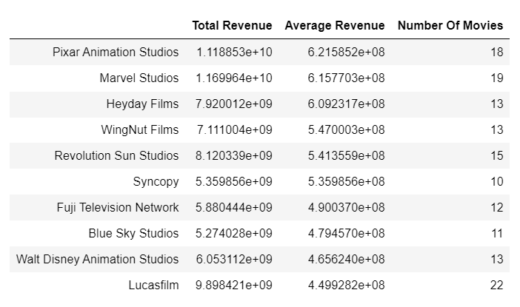
Which Production companies make most money in movie business?
Pixar Animation Studios has produced the most successful movies, on average.
Marvel Studios, with an average gross of 615 million dollars, comes in second.

Slide 8
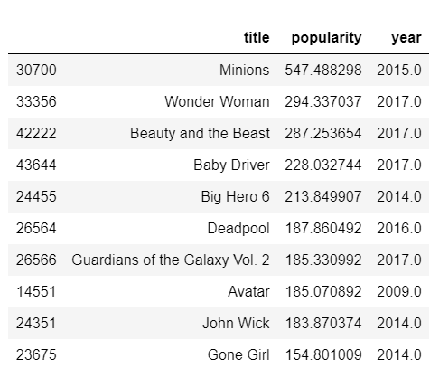
Which movies are more popular?
"Minions" is the most popular movie by the TMDB Popularity Score.
Wonder Woman and Beauty and the Beast come in second and third respectively.

Slide 9
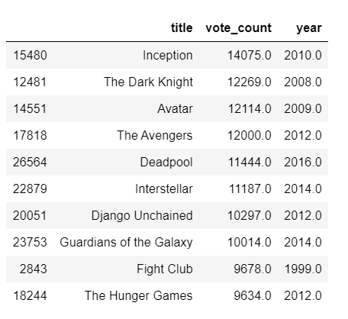
Which movies have been most voted by TMDB voters?
Inception and The Dark Knight, two critically acclaimed movies, are at the top of our chart.
It is interesting to note that Christopher Nolan directed both movies.

Slide 10
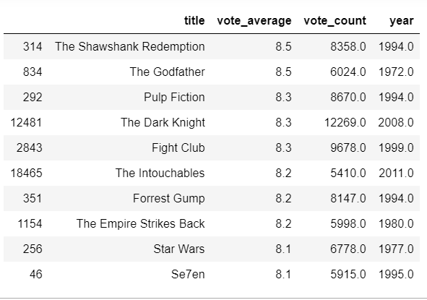
Which movies are most Critically Acclaimed?
We will only consider those movies with more than 5000 votes (similar to IMDB's criteria of 5000 options in selecting its top 250).
The Shawshank Redemption and The Godfather are the two most critically acclaimed movies in the TMDB Database.

Slide 11

Do popularity and vote average share a tangible relationship?
The Pearson Coefficient of the two quantities, is 0.154, suggesting no definite correlation.
In other words, popularity and vote average and independent quantities.

Slide 12
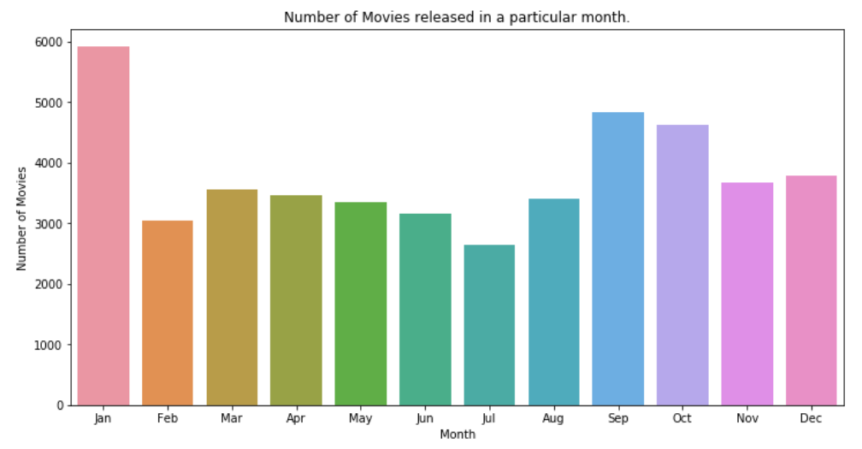
Does Release Dates play a significant role in determining the revenue of a movie?
We will gain insights about release dates in terms of months.
Extracted the month for each movie from release date.
January is the most popular month when it comes to movie releases.
This is also known as the dump month in Hollywood circles when the dozen release subpar movies.

Slide 13
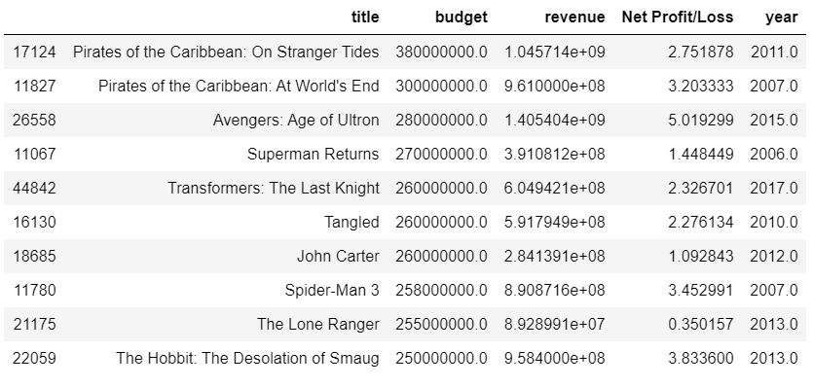
Which are the most expensive movies of all time?
Two Pirates of the Caribbean films occupy the top spots in this list with a staggering budget of over 300 million dollars.
All the top 10 most expensive movies made a profit on their investment except for The Lone Ranger
“The Lone Ranger “ managed to recoup less than 35% of its investment, taking in a paltry 90 million dollars on a 255-million-dollar budget.

Slide 14

How strong a correlation does the budget hold with the revenue?
A stronger correlation would directly imply more accurate forecasts.
The scatterplot shows a positive correlation between budget and revenue.

Slide 15
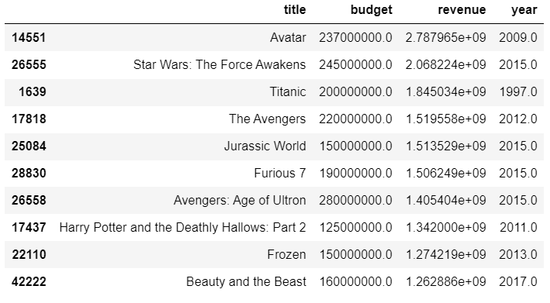
Which are the Highest Grossing Films of All Time?
The world of movies broke the 1-billion-dollar mark in 1997 with the release of Titanic.
It took another 12 years to break the 2-billion-dollar mark with Avatar. James Cameron directed both these movies.
The highest-grossing movie does not necessarily mean the movie made the highest profit of all.

Slide 16
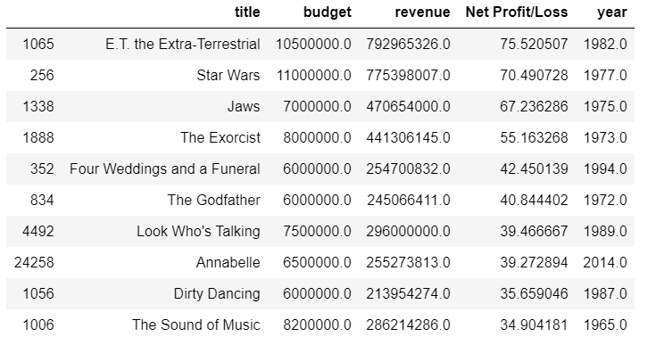
Which are the least and the most successful movies of all time?
Let us check the least and the most successful movies of all time.
we will only consider those movies which have a budget greater than 5 million dollars.
E.T. the Extra-Terrestrial is the most successful movie.
It is interesting to note that most of the successful movies in the top 10 list are released between 1965 - 1989.

Slide 17
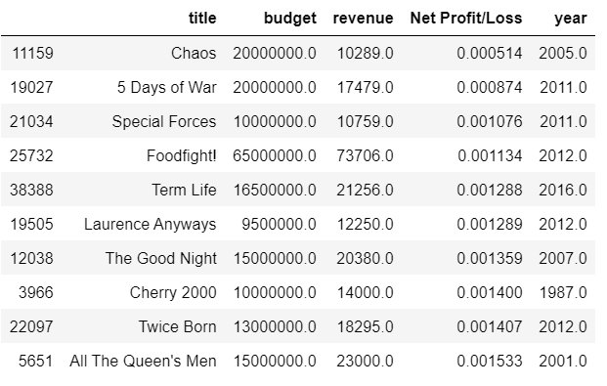
Which are the least and the most successful movies of all time?
Chaos is the least successful movie.
We can observe here that most of the movies listed in top 10 are released between 2000-2012
So is it that older movies were more successful than newer ones?
We cannot certainly say so as these figures have not been adjusted for inflation.

Slide 18
Conclusion

Slide 19
Recommendation

Slide 20


Thank You

